Slide 1
“Jumping The Barrier”
Service Delivery Framework
MIT October Plenary 2011
Jan Kok
Principal Innovator
Nokia Siemens Networks

Slide 2
Market Overview
Applications Strategy
SDF Overview
Exposure
Creatary
Smart Lab

Slide 3
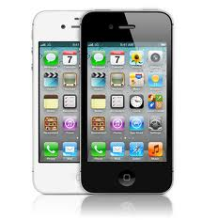
There are other people stealing the ‘buttons’ of the CSPs
… many button’s
One button
Where are the ‘Telco buttons’ for CSPs revenue?

Slide 4
How the CSP can rediscover their buttons for sustainable revenues?
Revenue
Core services
Dedicated implementation
Partner services
Fast service creation
Marketplace services
Exposure to developers
∑ Revenue
Revenue sources today (NSN Business Evolution Study, 2011: 146 interviews with 47 CSPs and 14 other companies)
SMS, MMS, IM
Voice (Mobile voice & VoIP)
Person to Person Messaging
Fixed Broadband
Mobile Internet
Entertainment
Content services like IPTV
Other Value Added Services
Advertising
Revenue from partner through 2-sided business models
Carrier services
Ringtones
Mobile TV
IPTV
Internet
Voice
VAS
Business
Services
Per-service revenue
Web2.0
Games
Virtual
Worlds
Source: ABI, NSN research
# of services

Slide 5


CSPs have under-leveraged assets to get the buttons back
Assets includes
Location
Profile
Billing
Messaging & voice
Contacts and history
Context and community
Deeper analytics
Best effort
Internet delivery
Delivery via CSP Network
Over
theTop
Telco
Public Internet
Service Provider
Strengths:
Innovative and fast moving
Excelling in application eco-system
Shortcoming:
End-to-end SLA
Charging capabilities
Strenghts:
Managed QoS and security across entire chain
Flexible carrier charging (Pre-paid, post-paid)
Shortcoming:
Smaller addressable market (Scale)
High service deployment cost
Slow T2M
Notes:
- The Disconnect

Slide 6
Market Overview
Applications Strategy
SDF Overview
Exposure
Creatary
Smart Lab

Slide 7
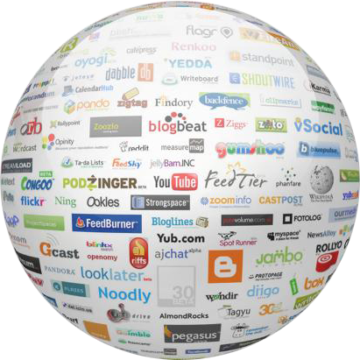


Innovate and deliver new services
CSP Challenges and opportunities
Challenges
Operator Assets
Opportunities
Customer demand for new applications
Competition by Web 2.0 Players
Erosion of voice revenues
Communication Infrastructure ownership
Trusted partner for consumers and enterprises
Customer Insight
Offer unique, smart, services and apps
Address untapped markets
New business models
Smart Phones
Music
Dating
CSP
Browsing
Social Media
Games
Video Streaming
Notes:
New customer demands and new competitors challenge the business of CSPs. However, the CSP’s control of the infrastructure and subscribers provides an excellent base for new business opportunities.

Slide 8
Market Overview
Applications Strategy
SDF Overview
Exposure
Creatary
Smart Lab

Slide 9
Service Delivery Framework
System evolution to match new consumer and business expectations
∑ Revenue
Core services –specific effort justified
Fast service creation and flexible business models
Service exposure for 3rd parties
Revenue/service
SMS/MMS/IM
Ring
tones
IP &Mobile TV
Integrated
eMail
mCommerce
Internet
access
Televoting
Quadplay
Community
Push
To X
WEB3.0
Games
Virtual
worlds
Voice VAS
Business
Services
Mobile Music
Info
Call & Share
0
Core Services
(~ 20)
Partner Services
(20-100)
Marketplace Services
(100 → )
# of
Services
SDF reduces integration complexity and multiple integration steps
Applications
APIs
SDF
Enabler
Notes:
Here we see a slide that captures the main driver for an SDP.
On the left it shows the traditional standards-based core Telco services whose usage and coverage justifies dedicated HW & SW platforms.
But as we move along the x-axis there is a new set of services that are being demanded by a smaller subscriber base with less revenue potential.
They don’t justify a dedicated platform, or a substantial update to a core services platform, or a proprietary method for adding intelligence to network-owned systems.
Then further on down the path we get to what’s sometimes called the ‘Long tail’ applications where there is even less financial justification for dedicated HW and/or SW. Not only that but there is an open marketplace for 3rd party services that could use operator-owned network functions. The rate at which subscribers, via the operator’s marketing dept, expect new applications increases and the use case and business model requires the operator’s systems to make network-owned functions (e.g. identity management, payment handling, content adaptation, virus protection, traffic optimisation) available to remote 3rd party systems.
To develop business from this ‘long tail’ operators need systems that support the new application deployment environment. They need service delivery platforms that reduce the time and effort required to launch a new service for their subscribers.

Slide 10




SDF High level architecture
Six main domains
3rd party applications & content
Content Providers
3rd party applications
Web 2.0 applications
Service Delivery Framework
BSS
5. Content Mgmt & Delivery
4. Enablers
3. SOA instrumentation
6. OSS/
BSS
Gateway
Portal
Common User Data Mgmt
Identity
Management,
AAA,
Profile &
Preferences,
…
Location
2. Service
Creation
Presence
1. Service Execution Environment
OSS
VoIP
Applications
Online Charging
Device capability Management
Devices
Network
PC + TV + Mobile + Phone
IMS
TV
(mobile, cable, IP)
IN/SSF
Others
(SMSC/MMSC/…)

Slide 11
Market Overview
Applications Strategy
SDF Overview
Exposure
Creatary
Smart Lab

Slide 12
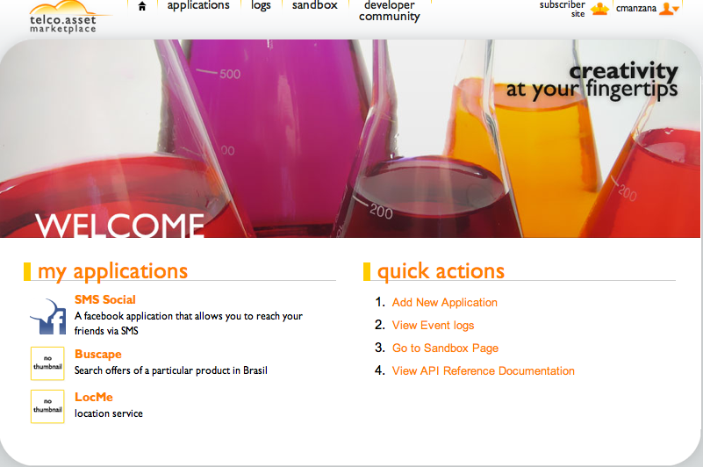
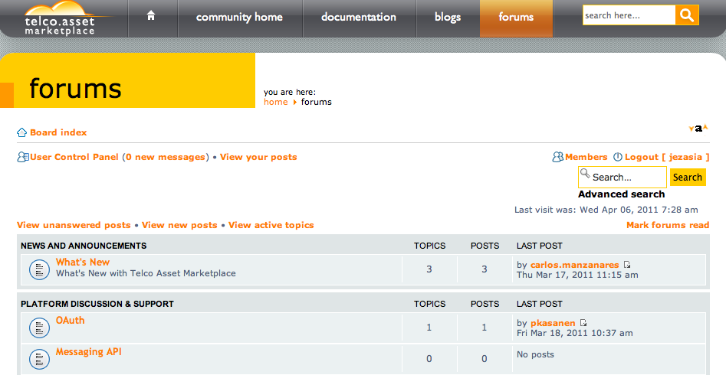
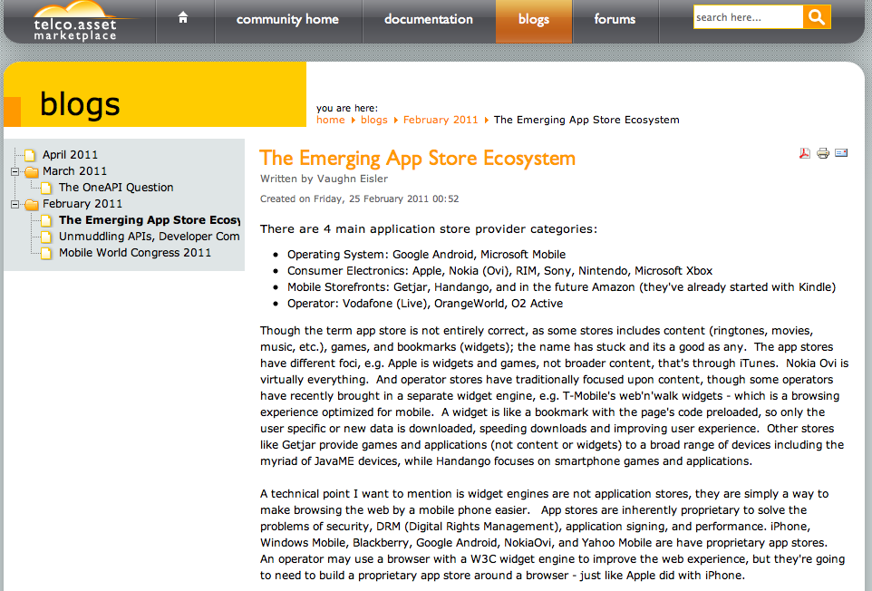
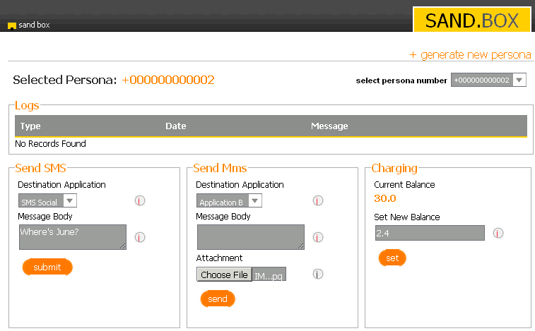
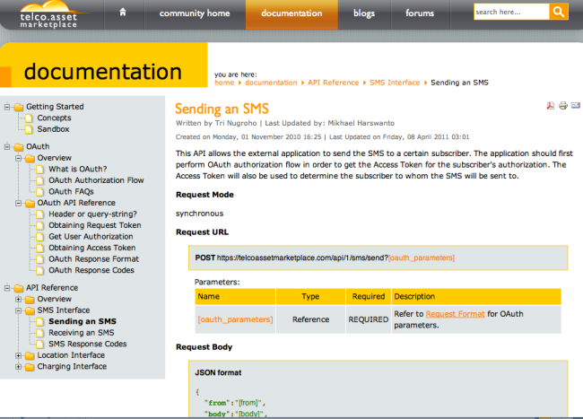
NSN Exposure Solution and Developer Communities www.Creatary.com
Easy on-boarding process for developers, charging and settlement for assets, sandbox environment for testing, API reference, concepts, tutorials, forums, blogs

Slide 13

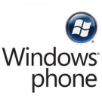


















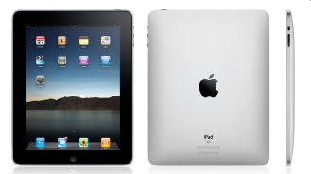
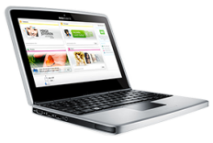



NSN Smart Labs
Focus on user experience and network performance
Fully equipped with latest radio technologies and end-to-end IP network
Foster mobile internet ecosystem and cooperation between key stakeholders
Devices
Connectivity
Internet content
Enhance user experience
Optimal interworking between
smart devices, applications
and networks

Slide 14
… many button’s
One button
The buttons are there … someone to push them.

